Slide 1
Data Visualisation using Tableau and Power-BI
Snehee Chheda
Anish Gharat
Dataset:
https://chronicdata.cdc.gov/Nutrition-Physical-Activity-and-Obesity/Nutrition-Physical-Activity-and-Obesity-Behavioral/hn4x-zwk7

Slide 2
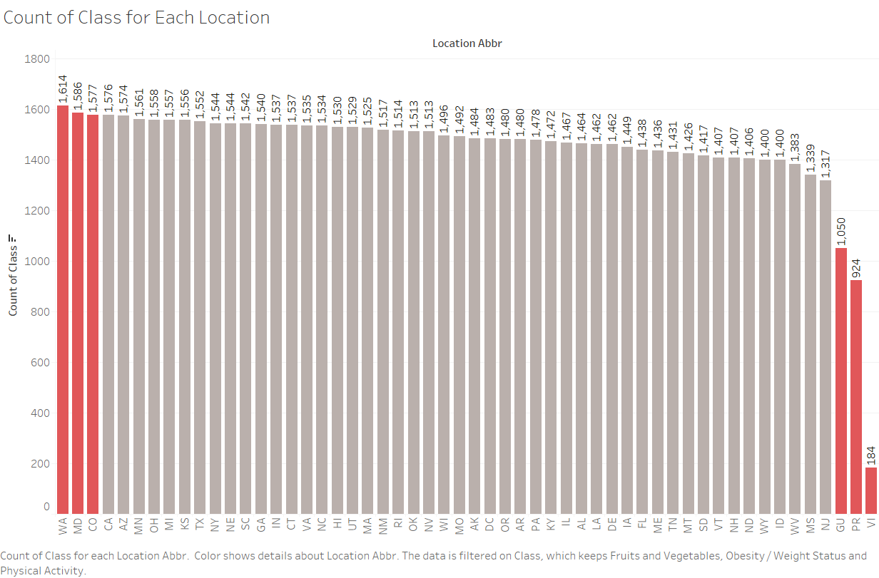

Slide 3
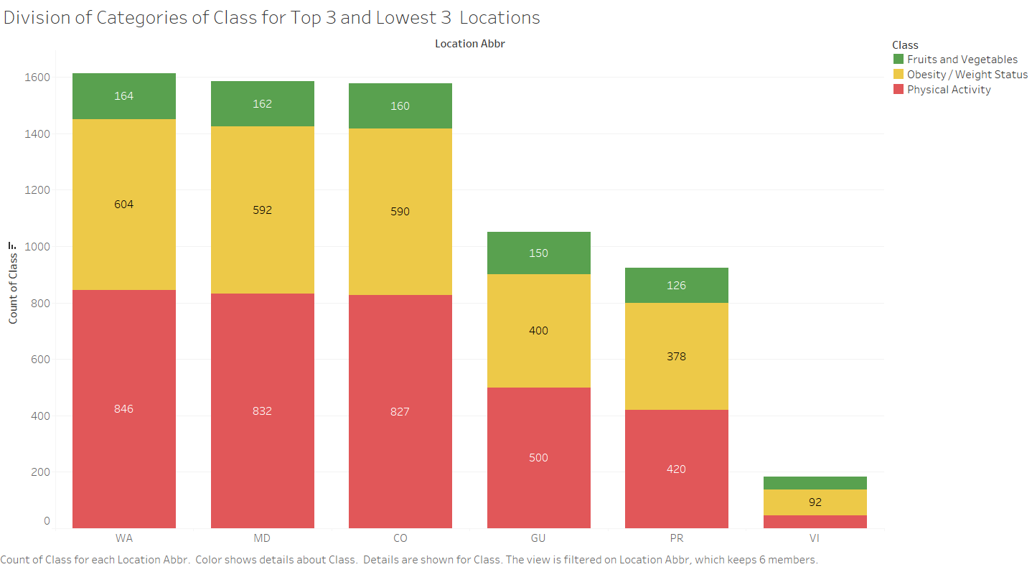

Slide 4
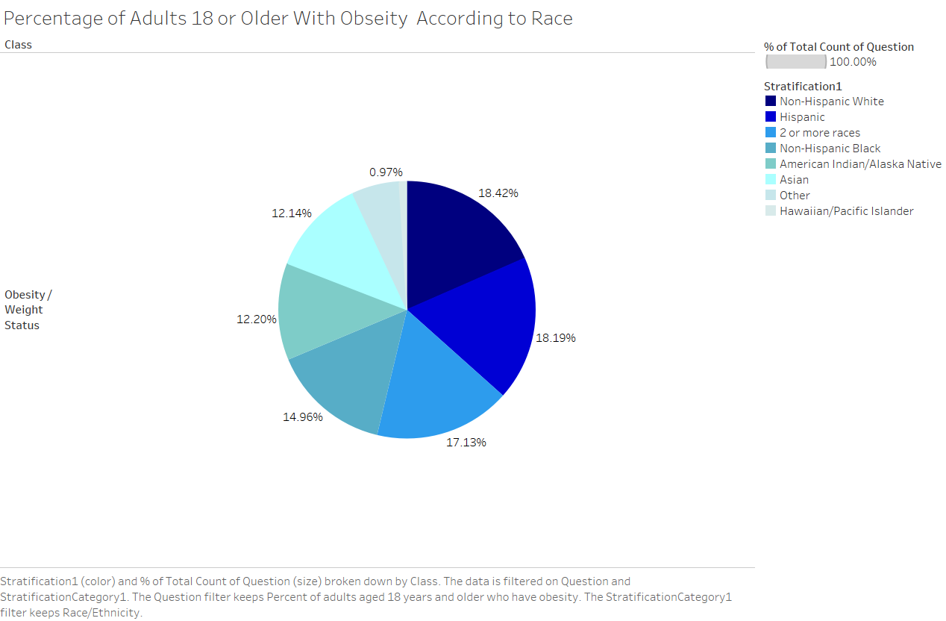

Slide 5
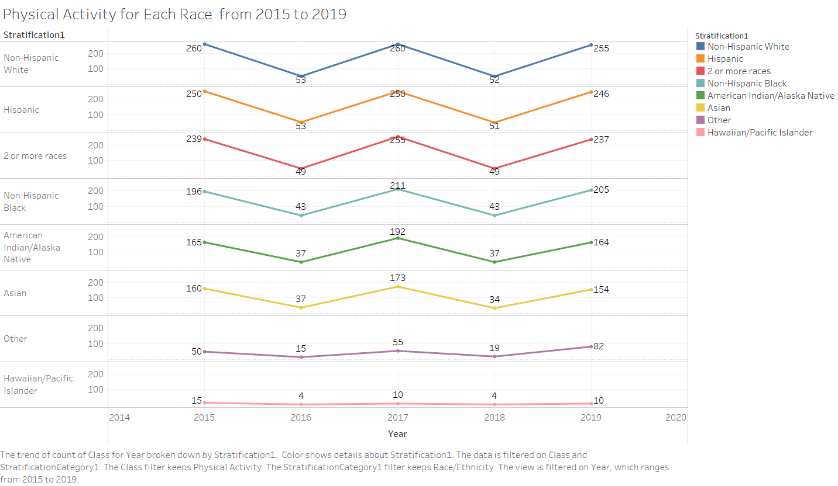

Slide 6
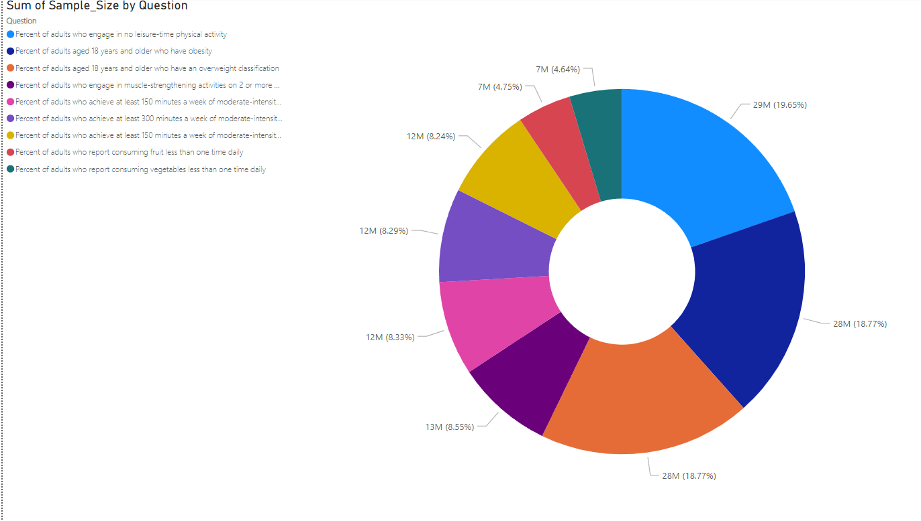

Slide 7
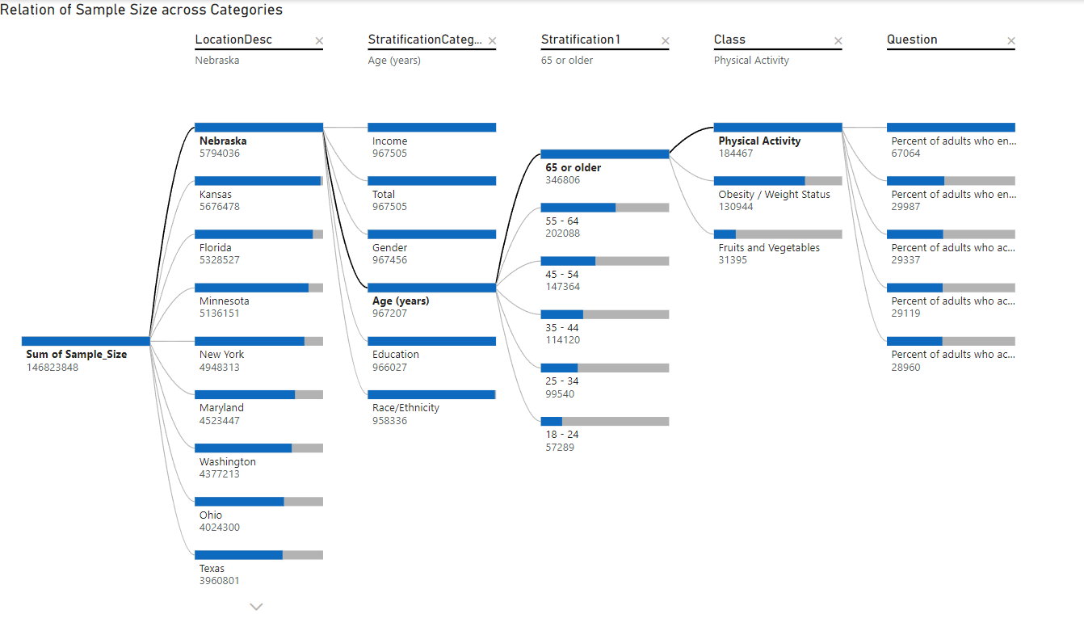
Notes:
Questions in order are: Percent of adults who engage in no leisure-time physical activity , Percent of adults who engage in muscle-strengthening activities on 2 or more days a week , Percent of adults who achieve at least 150 minutes a week of moderate-intensity aerobic physical activity or 75 minutes a week of vigorous-intensity aerobic activity (or an equivalent combination) , Percent of adults who achieve at least 300 minutes a week of moderate-intensity aerobic physical activity or 150 minutes a week of vigorous-intensity aerobic activity (or an equivalent combination) , Percent of adults who achieve at least 150 minutes a week of moderate-intensity aerobic physical activity or 75 minutes a week of vigorous-intensity aerobic physical activity and engage in muscle-strengthening activities on 2 or more days a week

